Slide 1
COMP 4621 Lab Tutorial #4
Spring 2015

Slide 2
Quick review
Lab 1. Basic concepts and UDP socket
Lab 2. TCP socket
Lab 3. HTTP programming, multithreading
Lab 4. HTTP Range Request, programming project

Slide 3
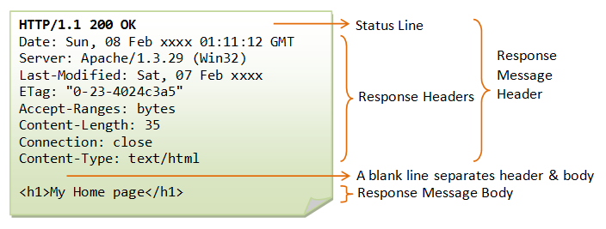
HTTP Response
Web server attaches web content with HTTP response

Slide 4
Some drawbacks…
What if the content is a very large file, e.g., a video
Bandwidth issues
Bad user experience
Solutions?
HTTP Range Request
HTTP progressive download
Other Streaming protocols

Slide 5
HTTP Range
New in HTTP/1.1
Only a portion of web content is responded from a server to a client.
client
Server
GET /test.mp4
Accept-Ranges: bytes
GET /test.mp4
Range: bytes=0-100
206 Partial Content
Content-Range: bytes 0-100/500
…
GET /test.mp4
Range: bytes=400-600
416 Requested Range Not Satisfiable
Content-Range: bytes 0-499/500

Slide 6
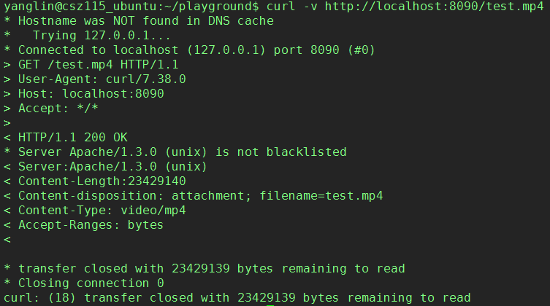
HTTP Range Interaction
Web server support range

Slide 7
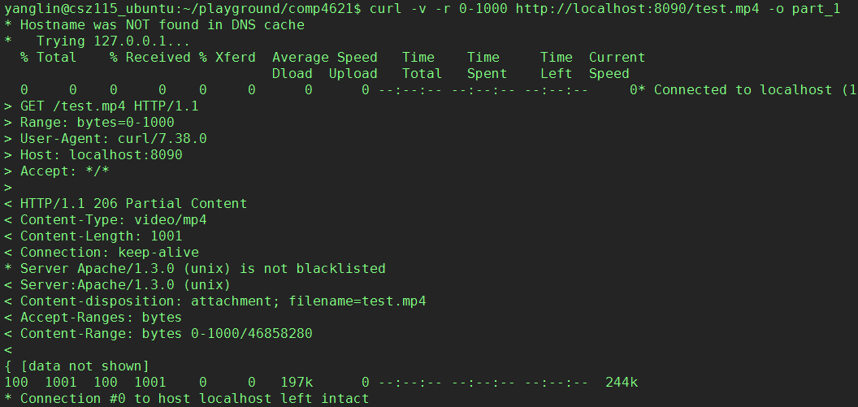
HTTP Range Interaction
Request 0~1000 bytes
Reply with first 1K bytes
Available range: 23MB

Slide 8
A Useful tool: curl
curl is a client to get documents/files from or send documents to a server, using any of the supported protocols (HTTP, HTTPS, FTP, GOPHER, DICT, TELNET, LDAP or FILE).
Some examples
curl -v http://localhost:8090/
curl -v -r 0-1000 http://localhost:8090/test.mp4 -o part_1
More can be find in curl --help
url to get
Verbose, show all request and reply
Range, only request a range of file

Slide 9
Practice
Implement HTTP range based on the webserver in tutorial 3
More references about HTTP range request:
http://www.cyberciti.biz/cloud-computing/http-status-code-206-commad-line-test/
http://benramsey.com/blog/2008/05/206-partial-content-and-range-requests/

Slide 10
Programming Project
A simple Web Server:
Handle basic request of web page (tutorial #1-3)
Handle multiple requests simultaneously (tutorial #3)
Handle request of downloading large file with HTTP Range(tutorial #4)

Slide 11
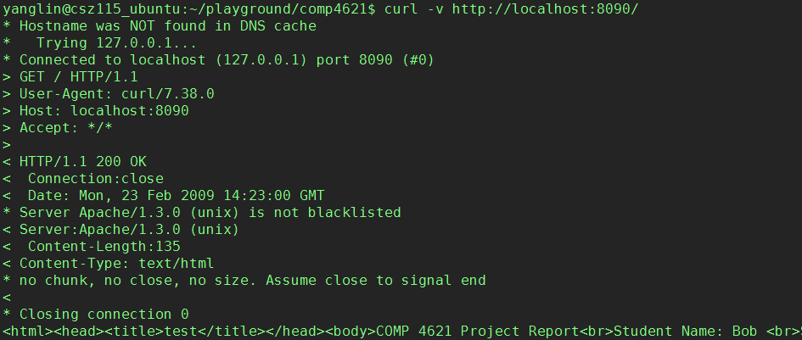
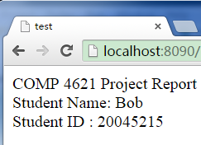
Programming Project
If client requests a default page, then replies with a simple web page, which shows your name and student ID.
Requesting default webpage

Slide 12
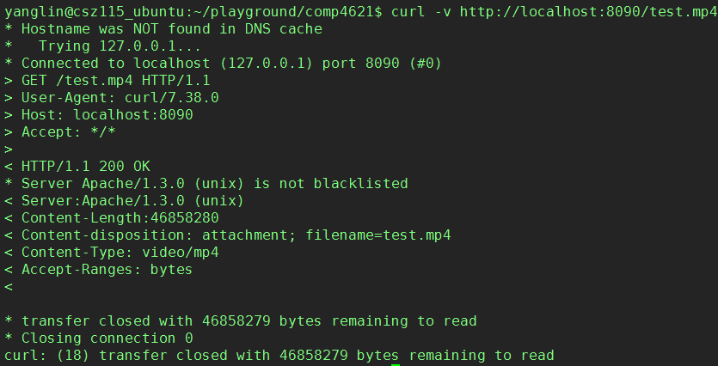
Programming Project …
If the client requests “test.mp4” (hardcode this name in your code), then show support of HTTP range
Requesting a video file
Indicating support of HTTP range

Slide 13
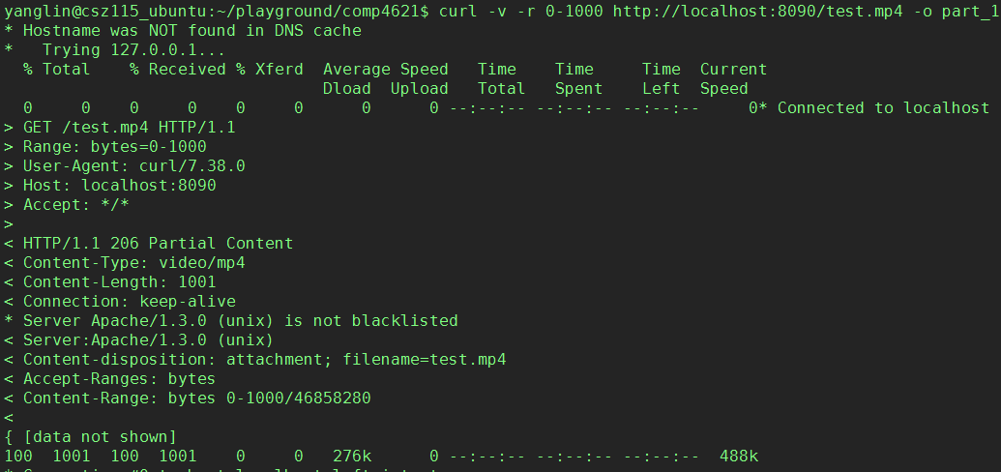
Programming Project …
If the client requests “test.mp4” with a valid range request, then replies specified data range
Requesting a range
Return specified range

Slide 14
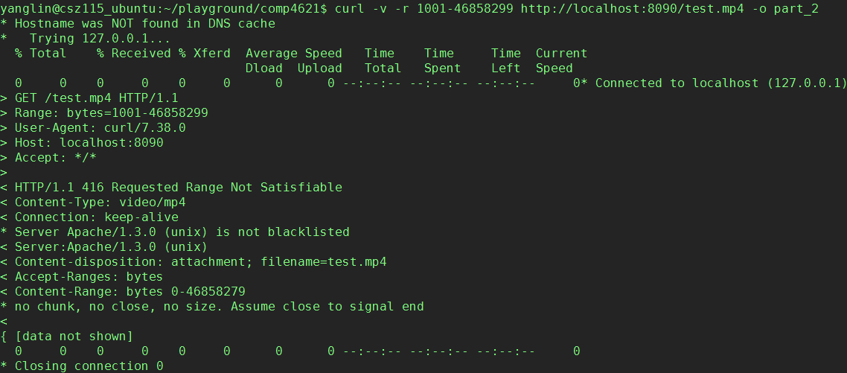
Programming Project …
If client request an invalid range, then return 416 Requested Range Not Satisfiable, use Content-Range header to indicate valid range
Requesting a range
Return error and valid range

Slide 15
Submission Requirement
A folder named as “name_studentID”, which should include
All source code (.java)
A two-page project report (Times New Roman, 11pts, single column)
No need to submit test.mp4, just hardcode this file name in your source code, e.g.,
if (strReqTarget.equals("/test.mp4")) { … }
The project report should explain:
Structure of your code, give explanation for import functions
How to handle multiple HTTP requests simultaneously?
How to handle HTTP request of webpage?
How to handle HTTP Range requests?
Please paste your test result with curl in your report

Slide 16
Marking scheme
Handle request of web page correctly (20%)
Handle multiple requests simultaneously (20%)
Handle request of Range appropriately (30%)
Support of range (10%)
Handle valid range request (10%)
Handle invalid range request (10%)
Project report (30%)

Slide 17
Implementation
You may start with webserver example we have implemented in lab tutorial 3
Some more functions need to implement:
Parse HTTP Request
Parse Range-related header
Implement HTTP range
Note:
When you access the test.mp4, please use a relative path, i.e., ./test.mp4
Do not package your code

Slide 18
Q&A

